Slide 1
Docker
COURSE OVERVIEW

Slide 2
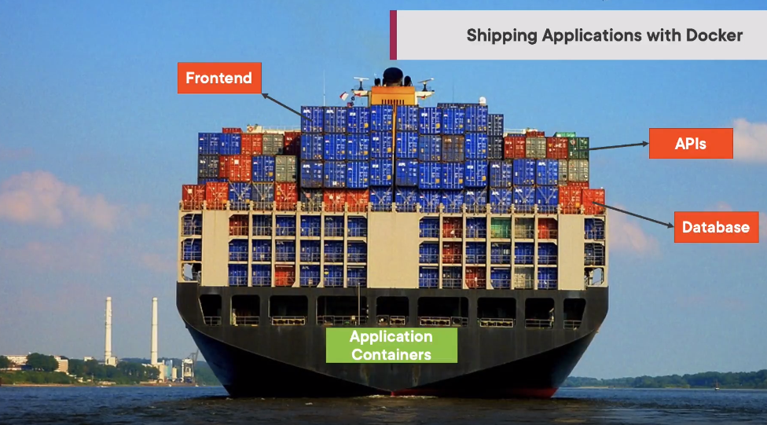

Slide 3
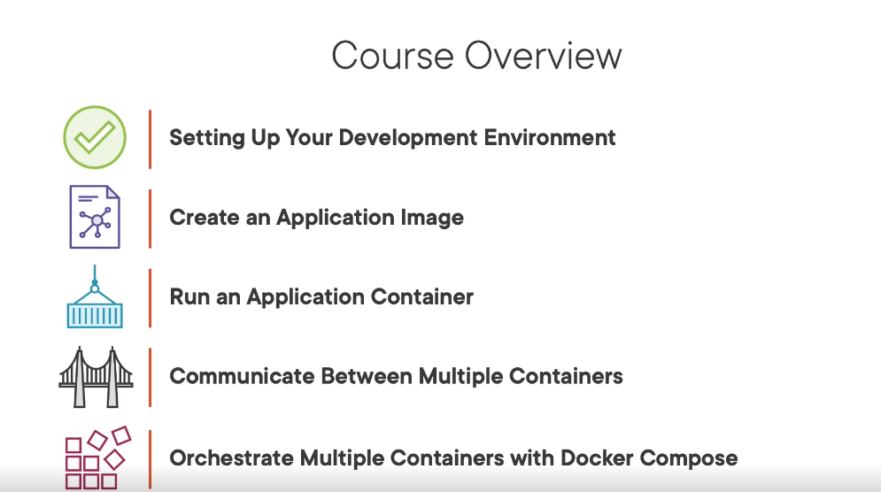

Slide 4
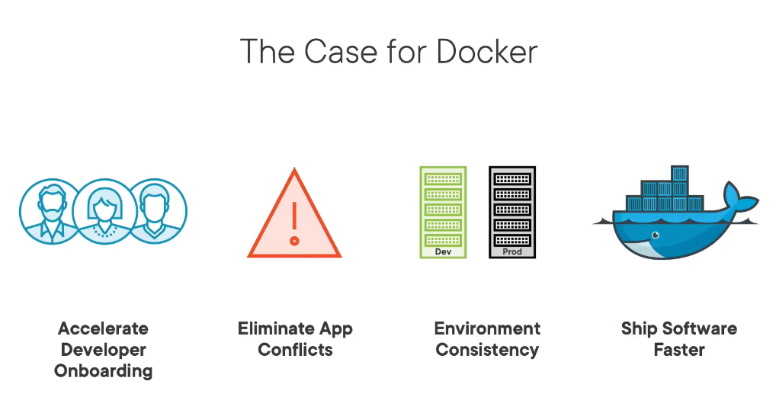

Slide 5
